Slide 1
Task 4
Team members
name | sec | bn
Mohammed Ahmed Hassan Ahmed | 2 | 37
Ibrahim Thabet Allam | 1 | 1
Mohammed Hatem Mohammed Saeed | 2 | 39
Mohamed Hassan Gad Ali | 2 | 41
Mohammed Abd El Mawgoud Ghoneam | 2 | 43

Slide 2
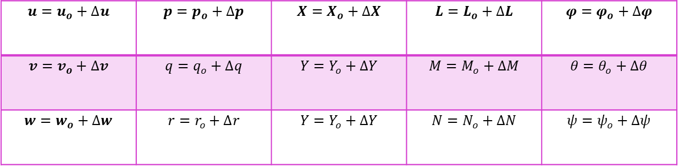
Linearization
By using small perturbation theory we can linearize EOM’s of the airplane
$$u=u_{o}+∆u$$ | $$p=p_{o}+∆p$$ | $$X=X_{o}+∆X$$ | $$L=L_{o}+∆L$$ | $$φ=φ_{o}+∆φ$$
$$v=v_{o}+∆v$$ | $$q=q_{o}+∆q$$ | $$Y=Y_{o}+∆Y$$ | $$M=M_{o}+∆M$$ | $$θ=θ_{o}+∆θ$$
$$w=w_{o}+∆w$$ | $$r=r_{o}+∆r$$ | $$Y=Y_{o}+∆Y$$ | $$N=N_{o}+∆N$$ | $$ψ=ψ_{o}+∆ψ$$

Slide 3
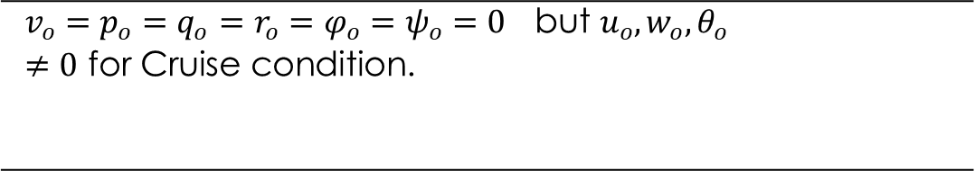
Reference Flight condition
$$v_{o}=p_{o}=q_{o}=r_{o}=φ_{o}=ψ_{o}=0 \text{but} u_{o},w_{o},θ_{o}≠0 \text{for} \text{Cruise} \text{condition}\text{.}$$

Slide 4
Linearization Technique
Step 1
step4
step3
Recast each variable in terms of a steady-state value and a perturbed value.
step2
Apply the small-angle assumption to trig functions of perturbed angle
Assume products of small perturbations are negligible.
Remove the steady-state equation from the perturbed equation.

Slide 5
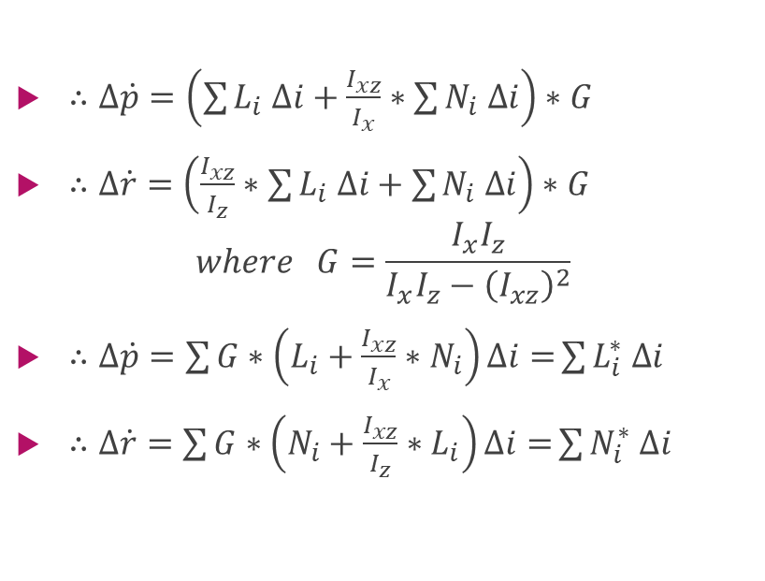
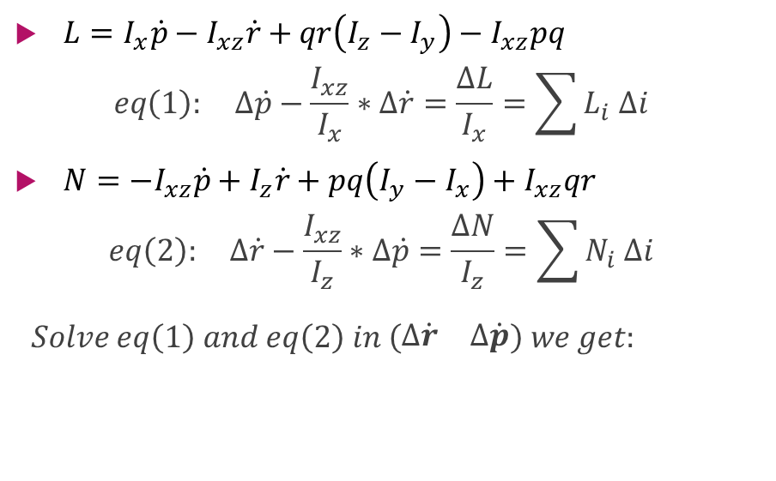
Notes in Lateral calculations
$L=I_{x}\dot{p}−I_{xz}\dot{r}+qr\left(I_{z}−I_{y}\right)−I_{xz}pq$
$$eq\left(1\right): ∆\dot{p}−\frac{I_{xz}}{I_{x}}∗∆\dot{r}=\frac{∆L}{I_{x}}=\sum{L_{i} ∆i}$$
$N={−I}_{xz}\dot{p}+I_{z}\dot{r}+pq\left(I_{y}−I_{x}\right)+I_{xz}qr$
$$eq\left(2\right): ∆\dot{r}−\frac{I_{xz}}{I_{z}}∗∆\dot{p}=\frac{∆N}{I_{z}}=\sum{N_{i} ∆i}$$
$$Solve eq\left(1\right) and eq\left(2\right) in \left(\begin{matrix}∆\dot{r} & ∆\dot{p}\end{matrix}\right) we get:$$
$∴∆\dot{p}=\left(\sum{L_{i} ∆i}+\frac{I_{xz}}{I_{x}}∗\sum{N_{i} ∆i}\right)∗G$
$∴∆\dot{r}=\left(\frac{I_{xz}}{I_{z}}∗\sum{L_{i} ∆i}+\sum{N_{i} ∆i}\right)∗G$
$$where G=\frac{I_{x}I_{z}}{I_{x}I_{z}−{\left(I_{xz}\right)}^{2}}$$
$∴∆\dot{p}=\sum{G∗\left(L_{i}+\frac{I_{xz}}{I_{x}}∗N_{i}\right)∆i=}\sum{L_{i}^{∗} ∆i}$
$∴∆\dot{r}=\sum{G∗\left(N_{i}+\frac{I_{xz}}{I_{z}}∗L_{i}\right)∆i=}\sum{N_{i}^{∗} ∆i}$

Slide 6
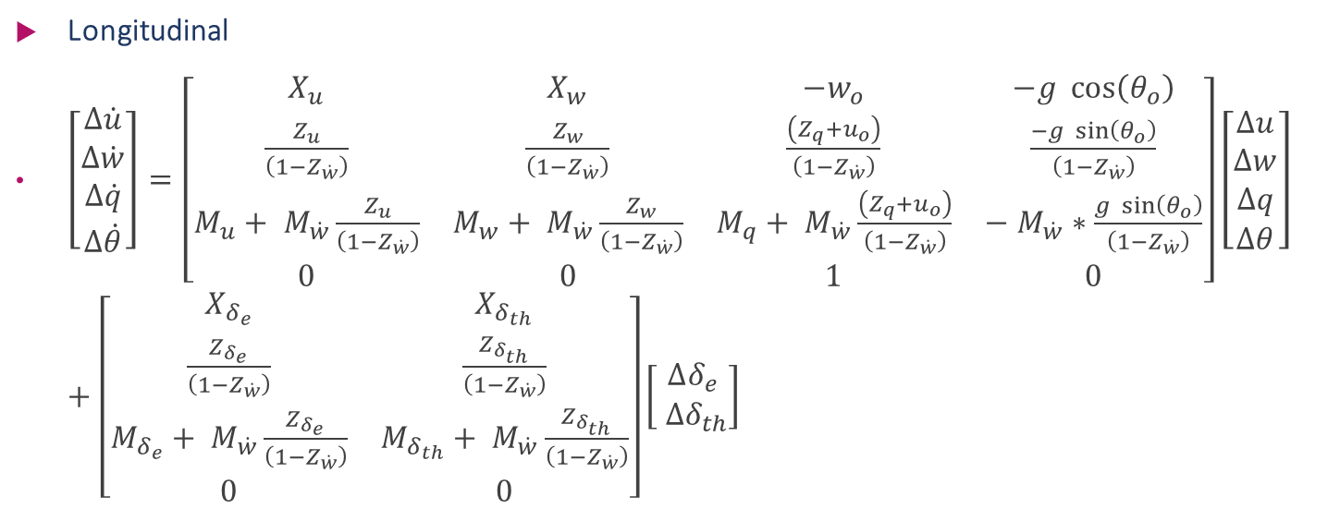
State space Model:
Longitudinal
$\left[\begin{aligned}Δ\dot{u} \\ Δ\dot{w} \\ Δ\dot{q} \\ Δ\dot{θ}\end{aligned}\right]=\left[\begin{matrix}X_{u} & X_{w} & −w_{o} & −g \cos\left(θ_{o}\right) \\ \frac{Z_{u}}{\left(1−Z_{\dot{w}}\right)} & \frac{Z_{w}}{\left(1−Z_{\dot{w}}\right)} & \frac{\left(Z_{q}+u_{o}\right)}{\left(1−Z_{\dot{w}}\right)} & \frac{−g \sin\left(θ_{o}\right)}{\left(1−Z_{\dot{w}}\right)} \\ M_{u}+ M_{\dot{w}}\frac{Z_{u}}{\left(1−Z_{\dot{w}}\right)} & M_{w}+ M_{\dot{w}}\frac{Z_{w}}{\left(1−Z_{\dot{w}}\right)} & M_{q}+ M_{\dot{w}}\frac{\left(Z_{q}+u_{o}\right)}{\left(1−Z_{\dot{w}}\right)} & − M_{\dot{w}}∗\frac{g \sin\left(θ_{o}\right)}{\left(1−Z_{\dot{w}}\right)} \\ 0 & 0 & 1 & 0\end{matrix}\right]\left[\begin{aligned}Δu \\ Δw \\ Δq \\ Δθ\end{aligned}\right]+\left[\begin{matrix}X_{δ_{e}} & X_{δ_{th}} \\ \frac{Z_{δ_{e}}}{\left(1−Z_{\dot{w}}\right)} & \frac{Z_{δ_{th}}}{\left(1−Z_{\dot{w}}\right)} \\ M_{δ_{e}}+ M_{\dot{w}}\frac{Z_{δ_{e}}}{\left(1−Z_{\dot{w}}\right)} & M_{δ_{th}}+ M_{\dot{w}}\frac{Z_{δ_{th}}}{\left(1−Z_{\dot{w}}\right)} \\ 0 & 0\end{matrix}\right]\left[\begin{aligned}∆δ_{e} \\ ∆δ_{th}\end{aligned}\right]$

Slide 7
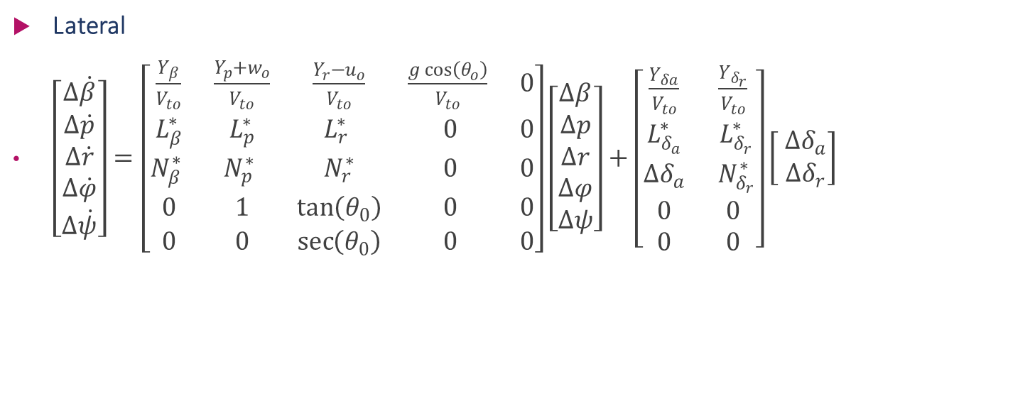
State space Model:
Lateral
$\left[\begin{aligned}Δ\dot{β} \\ Δ\dot{p} \\ Δ\dot{r} \\ Δ\dot{φ} \\ Δ\dot{ψ}\end{aligned}\right]=\left[\begin{matrix}\frac{Y_{β}}{V_{to}} & \frac{Y_{p}+w_{o}}{V_{to}} & \frac{Y_{r}−u_{o}}{V_{to}} & \frac{g\cos\left(θ_{o}\right)}{V_{to}} & 0 \\ L_{β}^{∗} & L_{p}^{∗} & L_{r}^{∗} & 0 & 0 \\ N_{β}^{∗} & N_{p}^{∗} & N_{r}^{∗} & 0 & 0 \\ 0 & 1 & \tan\left(θ_{0}\right) & 0 & 0 \\ 0 & 0 & \sec\left(θ_{0}\right) & 0 & 0\end{matrix}\right]\left[\begin{aligned}Δβ \\ Δp \\ Δr \\ Δφ \\ Δψ\end{aligned}\right]+\left[\begin{matrix}\frac{Y_{δa}}{V_{to}} & \frac{Y_{δ_{r}}}{V_{to}} \\ L_{δ_{a}}^{∗} & L_{δ_{r}}^{∗} \\ ∆δ_{a} & N_{δ_{r}}^{∗} \\ 0 & 0 \\ 0 & 0\end{matrix}\right]\left[\begin{aligned} ∆δ_{a} \\ ∆δ_{r}\end{aligned}\right]$

Slide 8
short period & Long period approximations of the Longitudinal dynamics
By solving the A matrix we get 2 pairs of conjugate roots the pair which has small real part has big settling time according to $T_{s}=\frac{4}{ζω_{n}}$ on the other hand with the pair which has bigger real part
By solving the A matrix we get 2 pairs of conjugate roots the pair which has small real part has big settling time according to 𝑇_𝑠=4/(𝜁𝜔_𝑛 ) on the other hand with the pair which has bigger real part

Slide 9
short period & Long period

Slide 10
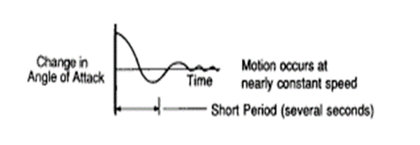
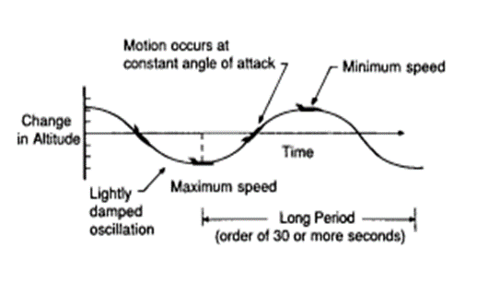
short period & Long period approximations of the Longitudinal dynamics
Short Period
Long period

Slide 11
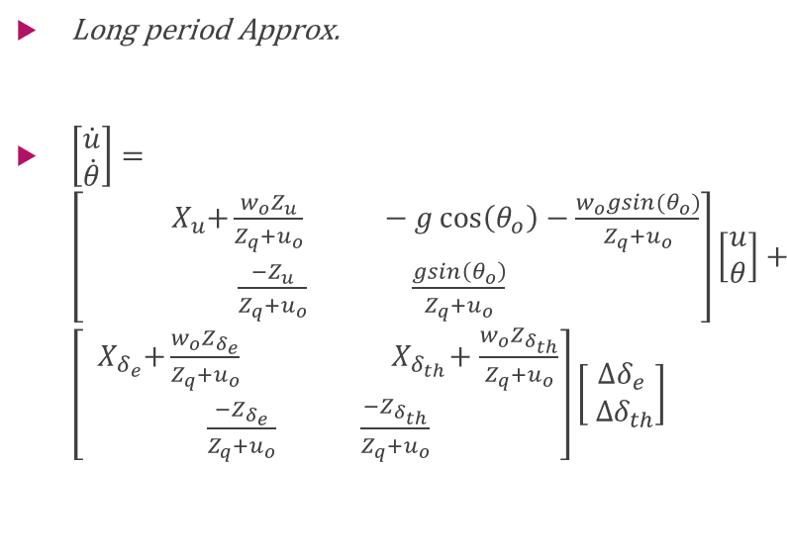
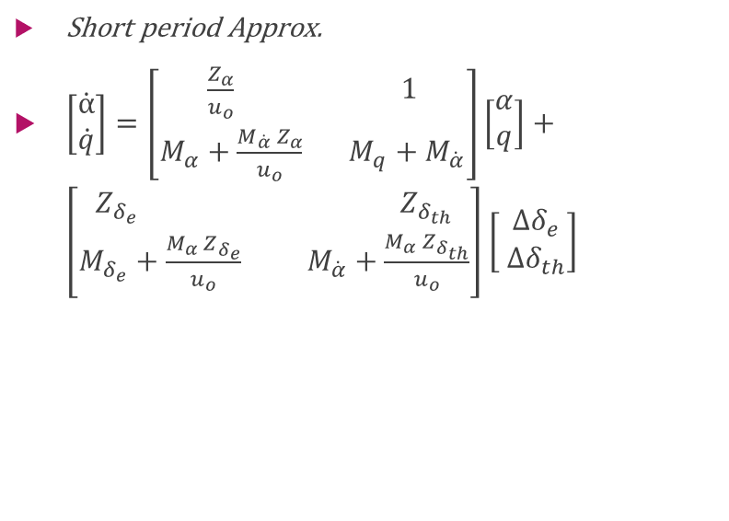
short period & Long period approximations of the Longitudinal dynamics
Short period Approx.
$\left[\begin{aligned}\dot{α} \\ \dot{q}\end{aligned}\right]=\left[\begin{aligned}\frac{Z_{α}}{u_{o}} 1 \\ M_{α}+\frac{{M_{\dot{α}} Z}_{α}}{u_{o}} M_{q}+M_{\dot{α}}\end{aligned}\right]\left[\begin{aligned}α \\ q\end{aligned}\right]+\left[\begin{aligned}Z_{δ_{e}} Z_{δ_{th}} \\ M_{δ_{e}}+\frac{{M_{α} Z}_{δ_{e}}}{u_{o}} M_{\dot{α}}+\frac{{M_{α} Z}_{δ_{th}}}{u_{o}}\end{aligned}\right]\left[\begin{aligned} ∆δ_{e} \\ ∆δ_{th}\end{aligned}\right]$
Long period Approx.
$\left[\begin{aligned}\dot{u} \\ \dot{θ}\end{aligned}\right]=\left[\begin{aligned}\begin{aligned}{ X}_{u}+\frac{w_{o}Z_{u}}{Z_{q}+u_{o}} −g\cos\left(θ_{o}\right)−\frac{w_{o}gsin(θ_{o})}{Z_{q}+u_{o}}\end{aligned} \\ \frac{−Z_{u}}{Z_{q}+u_{o}} \frac{gsin\left(θ_{o}\right)}{Z_{q}+u_{o}} \end{aligned}\right]\left[\begin{aligned}u \\ θ\end{aligned}\right]+\left[\begin{aligned}{ X}_{δ_{e}}+\frac{w_{o}Z_{δ_{e}}}{Z_{q}+u_{o}} { X}_{δ_{th}}+\frac{w_{o}Z_{δ_{th}}}{Z_{q}+u_{o}} \\ \frac{−Z_{δ_{e}}}{Z_{q}+u_{o}} \frac{−Z_{δ_{th}}}{Z_{q}+u_{o}} \end{aligned}\right]\left[\begin{aligned}∆δ_{e} \\ ∆δ_{th}\end{aligned}\right]$

Slide 12
Results due to elevator input 5 degree

Slide 13
Results due to elevator input

Slide 14
Results due to Thrust input 10000

Slide 15
Results due to Thrust input 10000

Slide 16

Full linear model root locus of $u/δ_{e}$

Slide 17

Long period model root locus of $u/δ_{e}$

Slide 18

Full linear model root locus of $q/δ_{e}$

Slide 19

short period model root locus of $q/δ_{e}$

